Slide 1


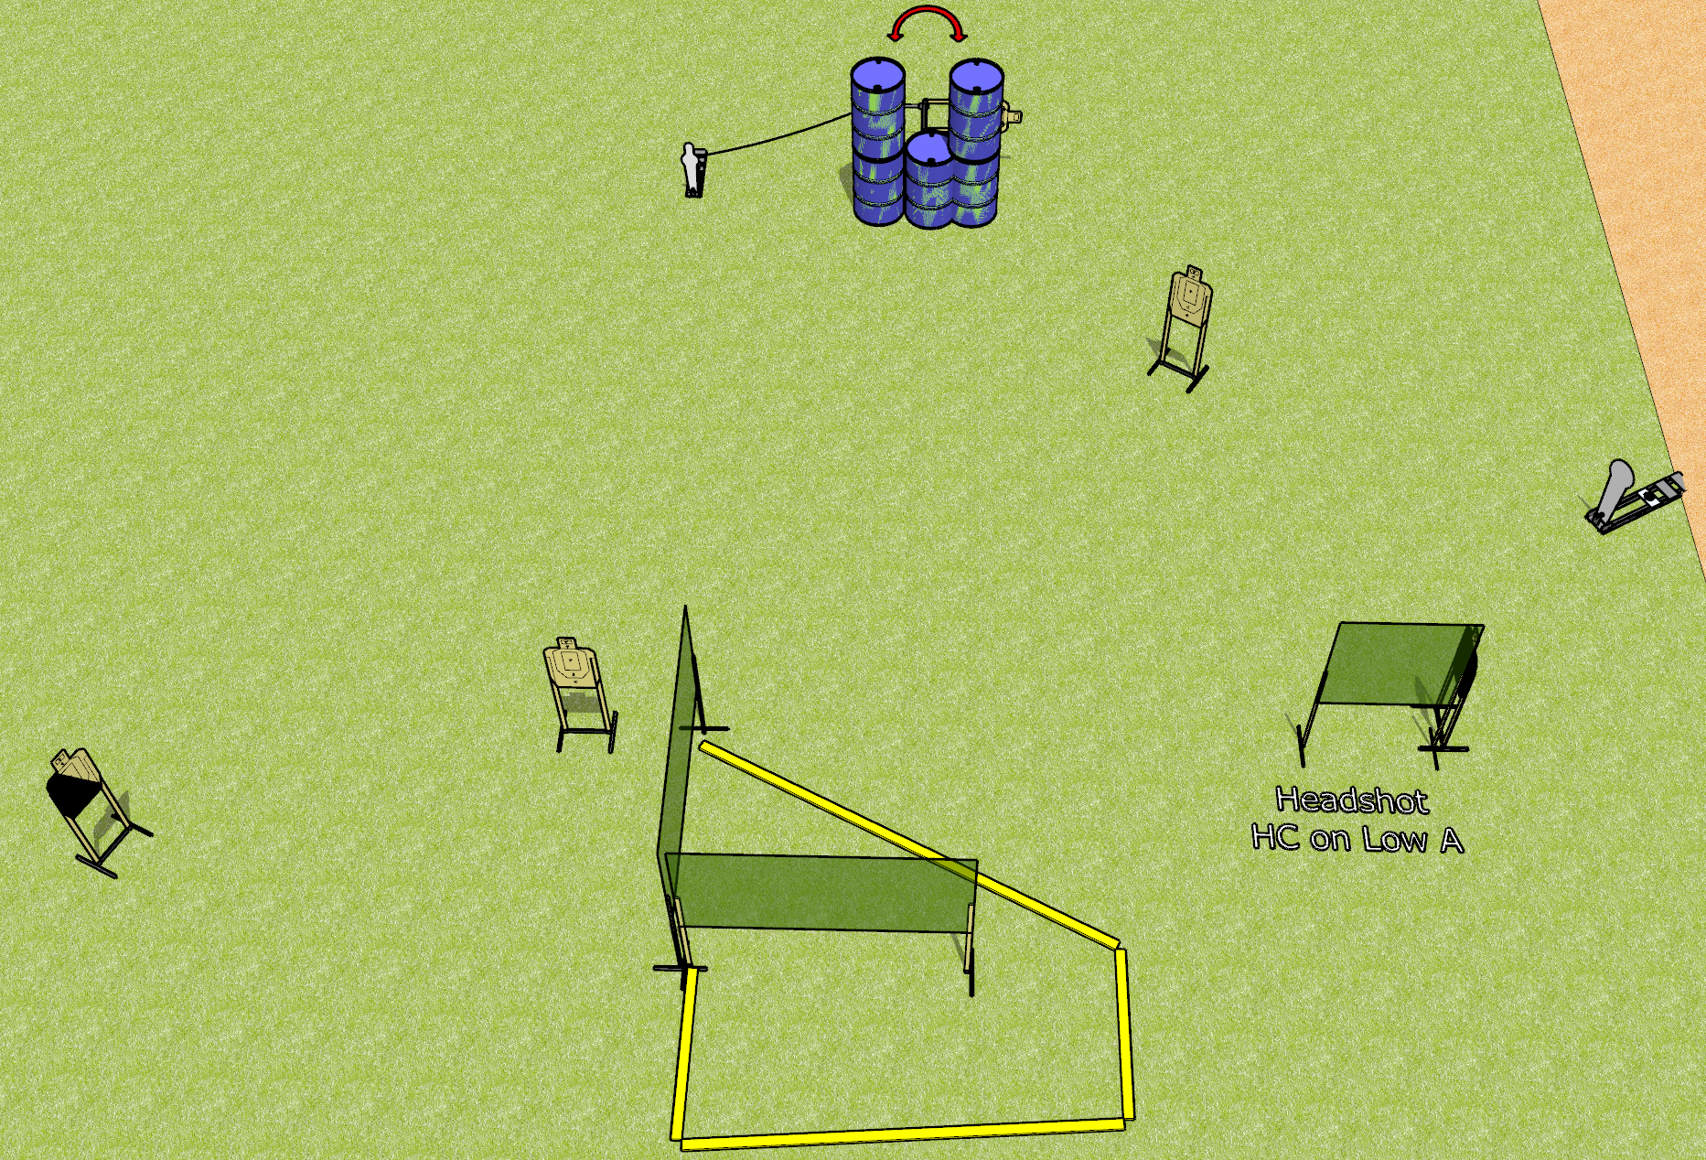
 | Dothan Gun Club – USPSA Match The Long Way Round Course Designer : Drew Coleman
12 rounds 5 USPSA targets 1 colt popper, 1 mini popper
Equipment List 1 swinger + activator 5 wall feet 1 left diagonal, 1 headshot (tape on top of lower A)

Slide 2
The Long Way Round
Written Stage Briefing
The Long Way Round is a 12 round, 60 point, Comstock short course. There are 5 USPSA targets, 1 colt popper, and 1 mini popper. The best 2 hits on paper will score, and steel must fall to score. The start signal is audible.
The swinger is activated by the mini popper. Please check the activator prior to walkthrough and set it the same way every time.
Handgun start position is straddling a fault line, wrists below belt. Handgun is loaded and holstered.
PCC start position is straddling a fault line. Loaded carbine is held with both hands, stock on belt, safety on.
On start signal, engage targets as they become available from within the shooting area.

